Slide 1

Data conversion

Slide 2
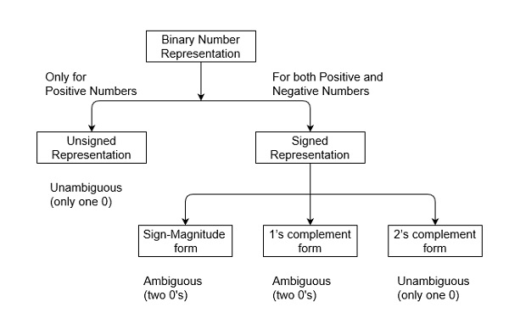
Representation of Binary Numbers
Variables such as integers can be represent in two ways, i.e., signed and unsigned.
Signed numbers use sign flag or can be distinguish between negative values and positive values.
Whereas unsigned numbers stored only positive numbers but not negative numbers.

Slide 3
Unsigned Numbers
Unsigned numbers don’t have any sign, these can contain only magnitude of the number. So, representation of unsigned binary numbers are all positive numbers only. For example, representation of positive decimal numbers are positive by default.
We always assume that there is a positive sign symbol in front of every number.

Slide 4
Signed Numbers
Signed numbers contain sign flag, this representation distinguish positive and negative numbers.
This technique contains both sign bit and magnitude of a number.
In representation of negative decimal numbers, we need to put negative symbol in front of given decimal number

Slide 5
Representation of Signed Binary Numbers
There are three types of representations for signed binary numbers.
Because of extra signed bit, binary number zero has two representation, either positive (0) or negative
There are three ways of handling signed binary numbers
Sign and magnitude
One’s complement
Two’s complement

Slide 6
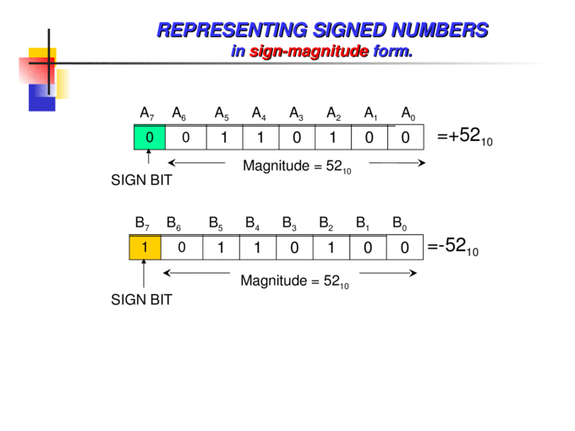
Sign and Magnitude
For n bit binary number, 1 bit is reserved for sign symbol. If the value of sign bit is 0, then the given number will be positive, else if the value of sign bit is 1, then the given number will be negative.
Remaining (n-1) bits represent magnitude of the number.
The first bit the Most Significant bit -MSB (left most bit /) is the sign of the number
1 means negative
0 means positive
The other bits give absolute value of the number
Example 1010₂ represents -2
0101₂ represents +5
Try these
Find the sign and magnitude of the following using 8 bits
40 and -37

Slide 7
One’s Complement
1’s complement of a number is obtained by inverting each bit of given number.
We represent positive numbers in binary form and negative numbers in 1’s complement form.
If value of sign bit is 0, then number is positive and you can directly represent it in simple binary form, but if value of sign bit 1, then number is negative and you have to take 1’s complement of given binary number.
You can get negative number by 1’s complement of a positive number and positive number by using 1’s complement of a negative number.
Therefore, in this representation, zero (0) can have two representation, that’s why 1’s complement form is also ambiguous form. The range of 1’s complement form is from (2(n-1)-1) to (2(n-1)-1) .

Slide 9
One’s Complement
The computer uses a system known as ones' complement can be used to represent negative numbers.
The ones' complement form of a negative binary number is the "complement" of its positive counterpart using the sign and magnitude representation
0: 00000000 (+0) and 11111111 (−0).
A number can be converted from positive to negative or negative to positive by calculating its one’s complement.
All 0 (zero) values of binary numbers are converted into1 (one) and all the 1 (ones) into 0 (zeros).

Slide 10
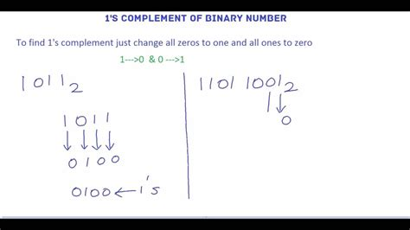
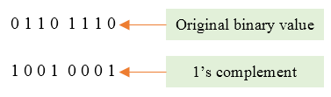
One’s complement
The one’s complement of binary is obtained by flipping the bits
1 change 0
0 change 1
Find the ones complement of 01101 using 8 bits
Write the number using 8 bits = 00001101
Flip the bits 11110010
What is the ones complement of -37 using 8 bits
Find the binary equivalent of + 37 = 100101
To make 8 bits add 2 zeros 00100101 To get the negative number flip the bit = 11011010

Slide 11
Twos Complement
2’s complement of a number is obtained by obtaining the 1s complement plus 1 to least significant bit (LSB).
A positive numbers in binary form and negative numbers in 2’s complement form.
There is extra bit for sign representation.
If value of sign bit is 0, then number is positive and you can directly represent it in simple binary form.
If value of sign bit 1, then number is negative and you have to take 2’s complement of given binary number. You can get negative number by 2’s complement of a positive number
A positive number by directly using simple binary representation.
If value of most significant bit (MSB) is 1, then take 2’s complement from, else not.

Slide 12
Twos Complement
The conversion is done using a two's complement binary, which requires the programmer to instruct the computer to interpret any binary number starting with 1 as negative.
The program then constructs the corresponding positive number in binary, takes its complement and adds one.
For example, given the number −47, the computer would create the binary number for +47: 00101111
The ones complement of this is: 00101111 = 11010000
Adding one to this gives: 11010000 + 1 = 11010001
Note that the computer has "signed" these numbers to treat a leading 1 as negative and process the results differently than simply adding up the powers of 2 occupied by the symbol 1.

Slide 13
Two’s complement
The two’s complement of binary is obtained by
Finding the one’s complement(Flipping the bits )
Add 1 to the result
Find the 2s complement of the -25 using 8 bits
Write done the equivalent of + 25 using 8 bits 00011001
Finds the ones complement by flipping the bits 11100110
Add 1 to the result 11100110 + 1 = 11100111
Find the 2s complement of the binary number 1001 using 8 bits
Write the binary of the number using 6 bits 00001001
Find the one’s complement == 11110110
Add 1 == 11110110 + 1 = 11110111

Slide 14
Representing Negative Numbers
The conversion is done using a two's complement binary, which requires the programmer to instruct the computer to interpret any binary number starting with 1 as negative.
The program then constructs the corresponding positive number in binary, takes its complement and adds one.
−31, the computer would create the binary number for +31:
0001 1111 = +31
1110 0000 flip the bits (1s complement)
+1 add 1 (2s complement)
1110 0001
The "signed" which is a 1 = as negative
1110 0001
-128 + 64 + 32+ 1 =-31

Slide 15
Practice Exercise
Convert the following binary to denary using the 2s complement method
10000101
1111001
01010110
11101101
Convert the following denary into binary using the 2s complement method
10000101
1111001
01010110
11101101

